Slide 1
Sina Salimian MD
Techniques of imaging of the aorta and its first order branches by endoscopic ultrasound

Slide 2
The evaluation of the aorta and its branches may be helpful
in the assessment of diseases primarily involving the aorta or its branches,
for assessment of invasion of the thoracic aorta in mediastinum and evaluation and staging of pancreaticobiliary malignancies.

Slide 3
EXTENT OF IMAGING
from its origin from the heart to the point of bifurcation at the L-4 vertebra from the following positions

Slide 6
Different parts of aorta and the position of imaging

Slide 8
IMAGING OF AORTIC ROOT AND LOWER PART OF ASCENDING AORTA
Anatomical landmark
The aortic root has a diameter of 2.4-4.7 cm (its diameter is more in males than females) and lies at the base of the left ventricle posterior to the right ventricular outflow tract.
From the aortic root, the ascending aorta passes upwards, forwards and to the right to continue as the arch at the level of upper border of the right second costal cartilage (sternal angle, lower border of the T4 vertebra).

Slide 9
It ascends anterior to the left atrium, right pulmonary artery and right principal bronchus, and posterior to the right ventricular outflow tract and beginning of the pulmonary trunk.

Slide 12
If you se one in long axis you will see the other in short axis

Slide 13
Technique of imaging
Identify the left atrium and right pulmonary artery.
The left atrium is identified as the largest pulsatile chamber at about 30 cm in the anterior wall of the esophagus.
The right pulmonary artery is seen above the left atrium.
Identify the root of the aorta.
The root of aorta is identified anteriorly to the upper part of the left atrium or right pulmonary artery
Rotation of the scope is able to identify the individual leaflets of the aortic valve. The origin of both coronary arteries can be visualized in this position.
Trace the ascending aorta from the aortic valve.
The ascending aorta is identified as a long tubular structure going up for a distance of about 5 cm from the aortic valve

Slide 15
Imaging of the branches
The right coronary artery arises from the right (anterior) sinus of Valsalva and the left coronary artery arises from the left (left posterior) sinus of Valsalva
The left coronary artery is followed-up easily for a distance of about 1-2 cm from its origin on EUS

Slide 20
ASCENDING AORTA, UPPER PART
This part lies at about 25-22 cm distance in the anterior wall of the esophagus.
The imaging of the uppermost part of the ascending aorta, the origin of the brachiocephalic trunk (BCT) and some part of the arch of the aorta is not possible (blind area of imaging) as the trachea and part of the left bronchus comes to lie between the esophagus and ascending part of the aorta.
This part of the aorta has no branches

Slide 22
THE ARCH OF AORTA AT 22 CM DISTANCE IN THE ESOPHAGUS
Anatomical landmark
The aortic arch begins as a continuation of the ascending aorta at the level of the upper border of the right sternocostal joint.
Its diameter ranges from 0.9 to 2.5 cm.
The lower border of the arch forms an important boundary of the aortopulmonary (AP) window

Slide 24
Technique of imaging of arch
The beginning and ending of the arch are present at the same level of the sternal angle.
the aorta is located in a rounded position at 22 cm distance and the upper and lower borders are identified
A rotation of EUS scope at this level is able to demonstrate most of the arch and its borders.
The outer border presents as a convexity facing anteriorly and to the left and the inner border presents as a concavity facing posteriorly to the right
From a rounded position, the entire arch can be traced by clockwise and anticlockwise rotation
Tracing of the upper border of the arch finds the origin of great vessels of the neck and tracing the lower border of the arch identifies the AP window
Imaging of AP window is possible either by focusing on the arch and descending aorta (DA) or by focusing on the pulmonary arteries.

Slide 27
Imaging of the aortopulmonary window with the descending aorta as the base
Follow the DA upward till it becomes the arch of the aorta.
Turn clockwise with a slight push to see the AP window
Alternative method initially the arch of aorta is visualized
Slight pushing up with anticlockwise torque is needed to see the AP window
As an alternative method initially the arch of aorta is visualized.
Slight pushing up with anticlockwise torque is needed to see the AP window

Slide 30
Imaging of aortopulmonary window with the pulmonary artery as the base
Identify the left atrium.
Pull back the scope till you start seeing the right pulmonary artery.
Continue slowly pulling back and once the tracheal rings start appearing on the cranial side, torque counter clockwise for about 90° and the AP window will be visualized
As an alternative method initially the left pulmonary artery is visualized through the lower part of the arch of the aorta.
Clockwise rotation along with up tilt will reveal the AP window

Slide 32
Imaging of branches
Three branches arise from the convexity of the arch, the BCT, left common carotid artery and left subclavian artery ​.
All the three arteries are crossed anteriorly by the left brachiocephalic vein
can be seen while tracing the upper border of the arch of the aorta.
The BCT usually lies in the blind area of imaging.
The imaging of the bronchial arteries is possible in the AP window

Slide 36
DESCENDING AORTA (THORACIC PART) 22-40 CM DISTANCE IN ESOPHAGUS
Anatomical landmark
The descending thoracic aorta extends from the level of lower border of the T4 vertebra to the aortic hiatus in the diaphragm in the midline at the level of lower border of the T12 vertebra where it continues as the abdominal aorta.
It is about 16-18 cm in length and the diameter of its mid portion ranges from 1.6 to 3.7 cm.
It lies in the posterior mediastinum, atfirst to the left of the vertebral column and then in front of the vertebral column. It descends successively posterior to the left pulmonary hilum and esophagus with which it is mutually spiralized to a limited extent and finally the diaphragm.

Slide 37
Technique of imaging
It is fairly easy to trace the DA by pushing along the posterior wall of the esophagus from the arch downwards
Imaging of the branches
The origin of the intercostal arteries can be seen from the left and right borders of descending thoracic aorta on clockwise or anticlockwise rotation of the scope. The course of right intercostal arteries is more easily traced as they go across the spine after indenting the posterior border of the AV
The left bronchial arteries can be sometimes traced in the AP window

Slide 40
DESCENDING AORTA
The DA in the abdominal part can be divided into three parts
The first part extends from the aortic hiatus to the upper border of the pancreas and lies posterior to the omental bursa
is related anteriorly to the origin of the first major branch of the abdominal aorta, the celiac artery at the T-12/L-1 vertebral level.
The second part lies posterior to the pancreas
is related anteriorly to the origin of the superior mesenteric artery (SMA) at the L-1/L-2 vertebral level.
The third part (the infra renal part) extends from the lower border of the pancreas to the aortic bifurcation and is related anteriorly to the origin of the inferior mesenteric artery at the L-3 vertebral level.

Slide 42
DESCENDING AORTA (ABDOMINAL AORTA) (POSTERIOR TO LESSER SAC)
Anatomical landmark
The abdominal aorta begins at the aortic opening of the diaphragm in the midline, at the level of the lower border of the T-12 vertebra and ends at the level of the lower border of the L-4 vertebra, slightly to the left of the midline, by dividing into two common iliac arteries. Its average length is about 10 cm and the diameter (1.7-2.3 cm) decreases from above downwards because of the origin of the large branches.

Slide 43
Technique of imaging

Slide 44
There are three ways of locating the DA in abdomen:
Pushing the scope into the stomach follows down the thoracic aorta into the abdominal part.
The thoracic aorta maintains a very close relationship to the esophagus but abdominal aorta goes away from the posterior wall of the stomach as the pancreas comes to lie between the aorta and stomach. The downward movement of the big wheel is usually required to follow the aorta. Following the thoracic aorta down and simultaneously moving the wheel down gives a sensation of climbing over a hill for an endosonographer akin to a car driver (in this case pancreas is the hill)
The second way of imaging is by probing at the esophagogastric junction (40 cm) with the wheels of the scope in a neutral position and slight tipping up to maintain contact with the posterior wall of the stomach.
The third way of imaging is by finding the liver during probing at 40 cm and 180° rotation to either side will locate the aorta.

Slide 45
Imaging of branches The imaging of DA from beyond the hiatus shows two vessels:
Celiac artery: The celiac artery is a short artery (length = 1.25 cm), which begins just below the median arcuate ligament where the left and right crura join and goes a little to the right side after taking origin from the aorta
A counterclockwise rotation with slight torquing and simultaneously pushing down slightly locate the celiac artery. Torquing is required as the origin of the celiac artery is usually on one side of the aorta and without torquing the origin of the celiac artery may be missed.
In general, more torquing than pushing is required and by torquing the trifurcation of artery into three, branches can be also identified

Slide 50
Left inferior phrenic artery: The left inferior phrenic artery is located just above the origin of the celiac artery.
Usually an application of color doppler over the anterior border of the aorta is required for locating the artery

Slide 52
DESCENDING AORTA (POSTERIOR TO PANCREAS)
Anatomical landmark
The imaging of this part of the aorta can be done from just beyond the esophagogastric junction near the posterior wall of the stomach or from the second/third part of the duodenum.

Slide 53
Technique of imaging
Initially, the scope is negotiated into the third part of the duodenum.
Slow pull out is done in a neutral position of the knobs.
Slight clockwise and anticlockwise rotation helps in finding and following the SMA from below upwards up to the point of its origin from the aorta
As an alternative method, pushing the scope down after locating the celiac artery from the stomach is able to locate the origin of the SMA fairly regularly.

Slide 55
Imaging of branches
The superior mesenteric artery is identified by the presence of pancreatic tissue between the SMA and aorta in imaging from the stomach or duodenum.
Slight clockwise and counterclockwise rotation at this level shows the origin of the right and left renal arteries also

Slide 57
DESCENDING AORTA BELOW PANCREAS
Anatomical landmark
The third part of aorta is crossed anteriorly by the third part of the duodenum
it is generally easier to image both the second and third parts of the abdominal aorta from second and third parts of the duodenum

Slide 60
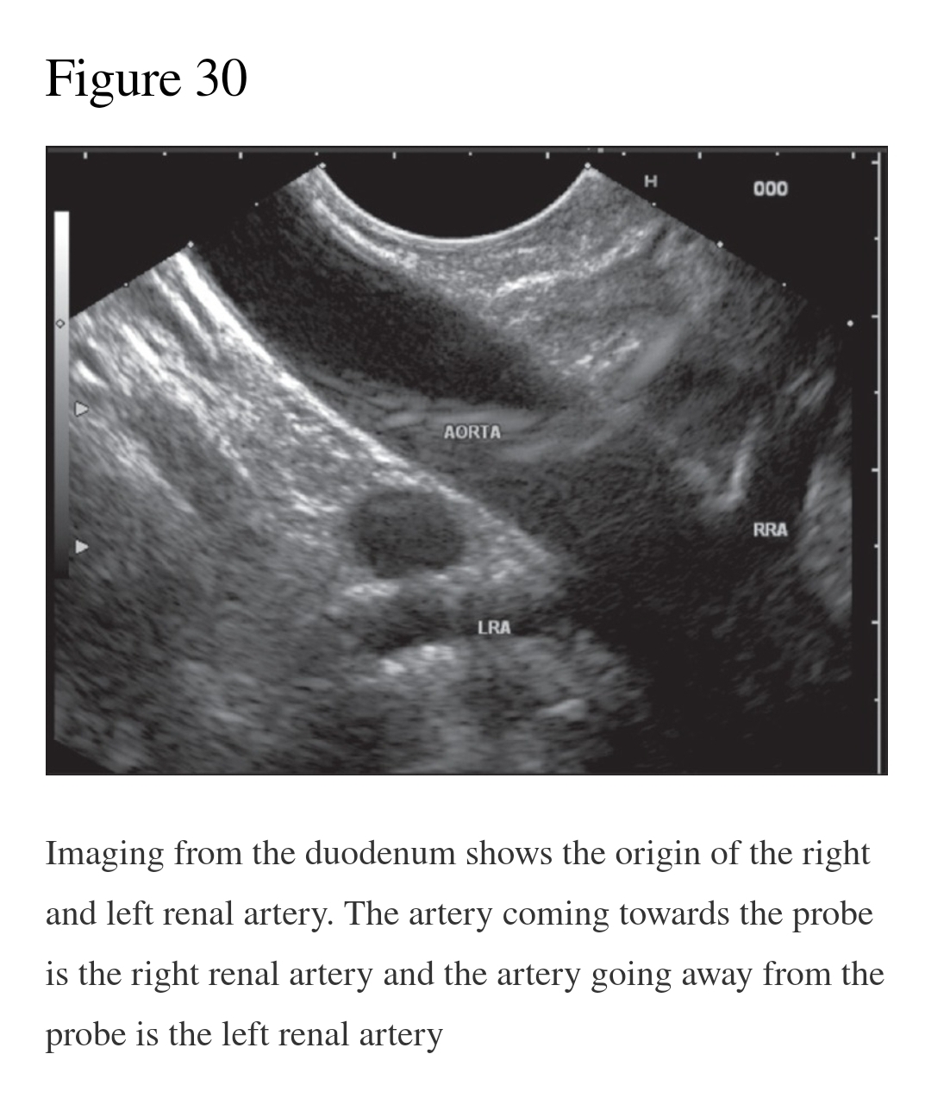

Slide 63
Technique of imaging
The scope is positioned in the duodenum and shortened in such a manner that the aorta may lie in one of the three positions.
The aorta may lie parallel, distal end close to the probe or proximal end close to the probe situation

Slide 65
Imaging of branches
The branches of this segment include the renal arteries, the lumbar arteries, the gonadal artery and the inferior mesenteric artery before the bifurcation of the aorta
Clockwise and anticlockwise rotation from this position is able to demonstrate the branches coming out of the aorta and the bifurcation
As an alternative method the bifurcation of the aorta can be seen from the stomach also
It is generally difficult to identify the inferior mesenteric artery in this position.
Sometimes the origin of the gonadal arteries can be identified at this level

Slide 66
IMAGING FROM RECTUM
The bifurcation of the aorta can be traced from the rectosigmoid junction and also the DA can be followed-up for a limited distance above the bifurcation by rectal ultrasound

Slide 68
Thanks

